Slide 1
Cga1121/ega1121/mga1121 – DATA STRUCTURES
Academic Year: 2023 – 2024
I Year / II Semester
Register Number : 927623BCS011
Name : M S ARUN SANJEEV
Department : Computer Science & Engineering

Slide 2
Title of the Project
TO – DO LIST APPLICATION

Slide 3
Abstract
The "To-Do List Application" project, developed using the C programming language, aims to create a simple, efficient, and user-friendly solution for managing daily tasks. This application addresses common productivity challenges by allowing users to create, update, delete, and view tasks systematically. Built with robust data structures such as linked lists, hash maps, and stacks/queues, the application ensures optimal performance and usability.

Slide 4
Abstract with CO/PO Mapping
Abstract | CO | POs | PSO
The "To-Do List Application" project, developed using the C programming language, aims to create a simple, efficient, and user-friendly solution for managing daily tasks. This application addresses common productivity challenges by allowing users to create, update, delete, and view tasks systematically. Built with robust data structures such as linked lists, hash maps, and stacks/queues, the application ensures optimal performance and usability. | s | PO1(2) PO2(3) PO3(2) PO4(2) PO5(3) PO6(1) PO7(3) PO8(2) PO9(3) PO10(3) PO11(2) PO12(2) | PSO1(3) PSO2(2)

Slide 5
Introduction
The "To-Do List Application" is a project aimed at developing an efficient and user-friendly task management tool using the C programming language. In today's fast-paced environment, managing tasks efficiently is crucial to maintaining productivity and meeting deadlines. Many people face challenges in organizing their daily activities, leading to inefficiencies and missed commitments. This application seeks to address these issues by providing a digital solution that allows users to easily create, manage, and track their tasks.

Slide 6
Data Structure Used
The Data Structures Used in To-Do List Application are
Linked List
Stack (Last In First Out)
Queue (First In Last Out)

Slide 7
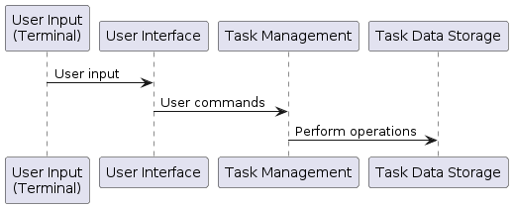
Proposed Architecture

Slide 8
Proposed Architecture - Description
The To-Do list application will be designed using a modular architecture, consisting of several interconnected components.
The to-do list project in C offers a minimalist terminal-based interface for task management. Users interact with a menu-driven interface to add, delete, and list tasks. Task data is stored locally within the program's memory.
These components will handle tasks such as user input, task management, storage, and user interface.

Slide 9
Proposed Architecture - Description
Add Task: The UI sends task details to TaskManager, which inserts the task into a LinkedList and confirms the insertion. TaskManager then enqueues the add task action and notifies the UI of the successful addition.
Delete Task: The UI requests TaskManager to delete a task by its ID. TaskManager removes the task from the LinkedList, confirms the removal, enqueues the delete task action, and notifies the UI.
Undo Action: The UI requests TaskManager to undo the last action. TaskManager dequeues the last action from the Queue, performs the undo operation on the LinkedList, and confirms the action's reversal to the UI. The User interacts with the UI to add, delete, and undo tasks.

Slide 10
List of Modules
User Interface: Responsible for interacting with the user and displaying task information.
Task Manager: Manages tasks, including creation, editing, prioritization, and completion.
Storage: Handles persistent storage of tasks using LINKED LIST,QUEUE,STACK CONCEPT , allowing users to access their tasks across sessions.

Slide 11
Thank You
Any queries???

